Slide 1
Automated Tumor Segmentation
Submitted by
Thlibi Mohamed Ali
2023/2024

Slide 2
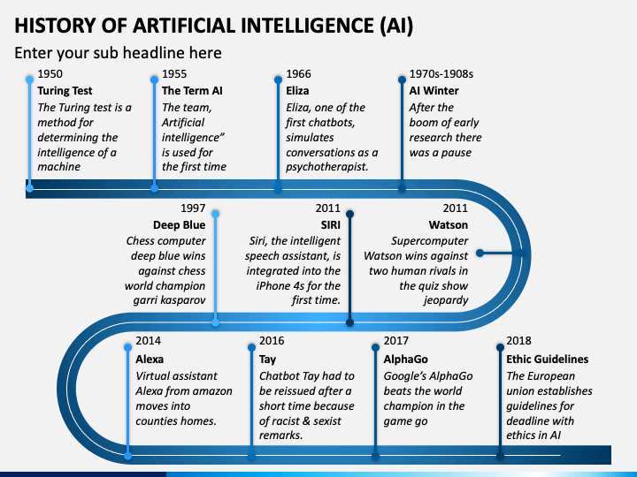
1

Slide 3
Transportation
Healthcare
Use of Artificial Intelligence
Robotics
Finance
Human Resources
Manufacturing
2

Slide 4
Use of Python
Python can be used on a server to create web applications. | Python can be used alongside software to create workflows. | Python can connect to database systems. It can also read and modify files. | Python can be used to handle big data and perform complex mathematics. | Python can be used for rapid prototyping, or for production-ready software development.
3

Slide 5
Avantages of Python
Python works on different platforms (Windows, Mac, Linux, Raspberry Pi, etc). | Python has a simple syntax similar to the English language. | Python has syntax that allows developers to write programs with fewer lines than some other programming languages. | Python runs on an interpreter system, meaning that code can be executed as soon as it is written. This means that prototyping can be very quick. | Python can be treated in a procedural way, an object-oriented way or a functional way.
4

Slide 6






Python libraries used in artificial intelligence
5

Slide 7
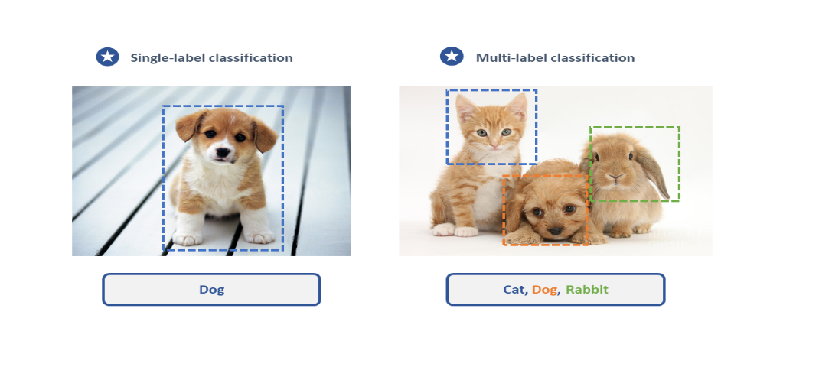
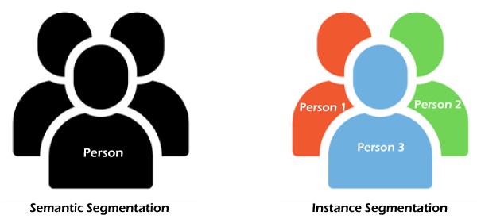
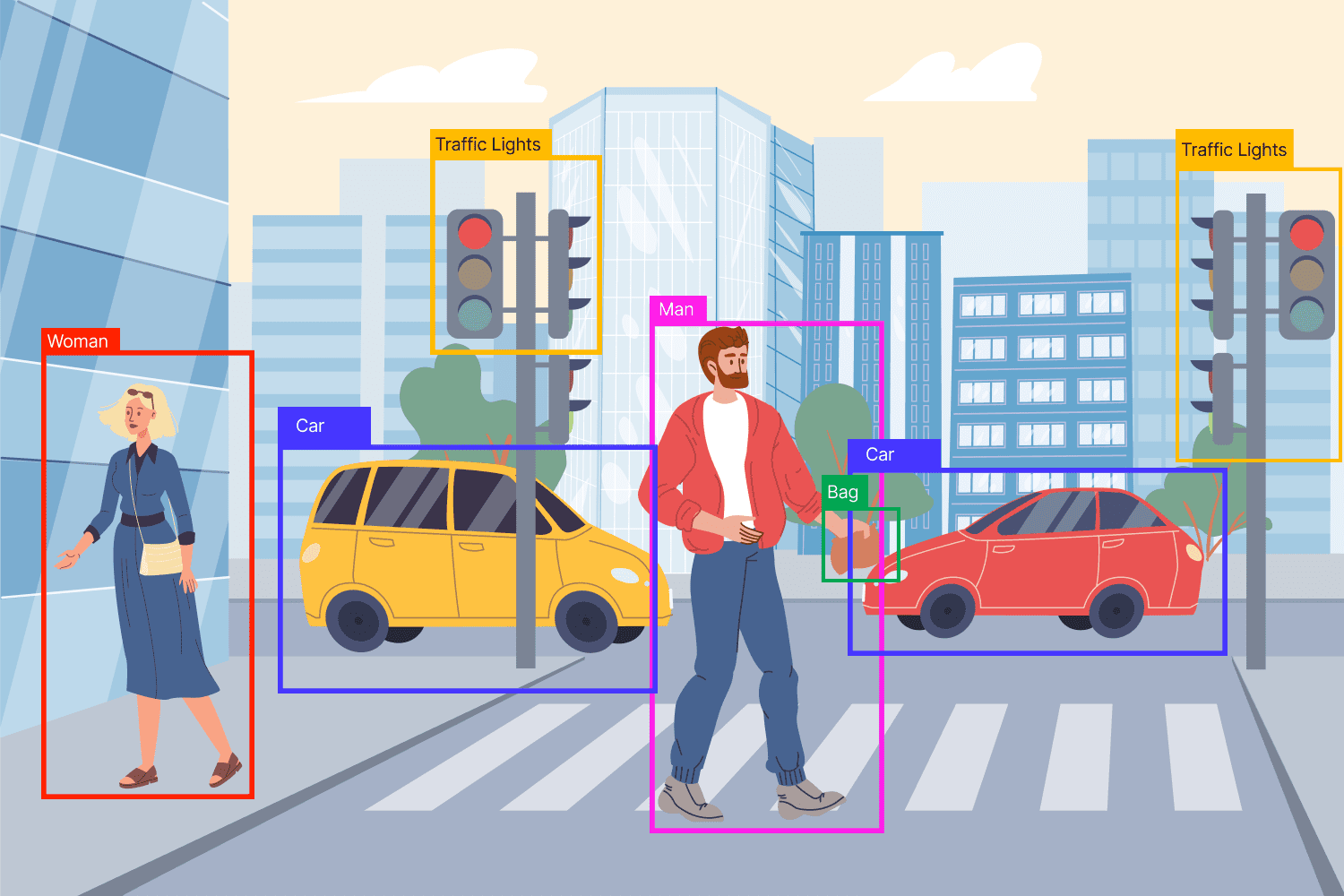
Computer Vision
Object detection
Image Classification
segmentation
6

Slide 8
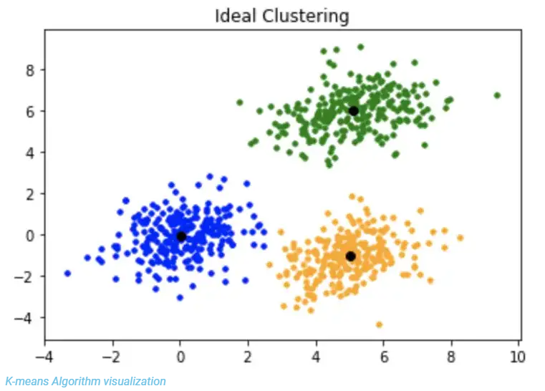
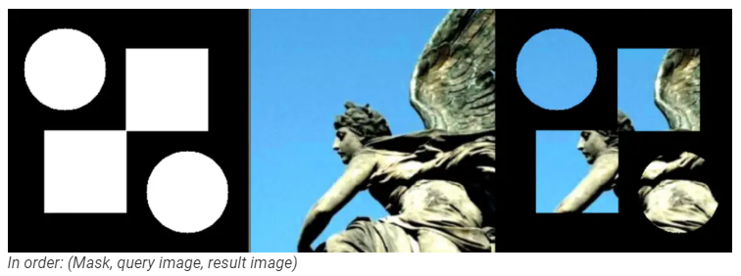
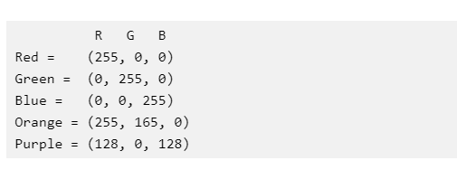
Image segmentation techniques in Opencv
K-means
Masking
Color Detection
7

Slide 9
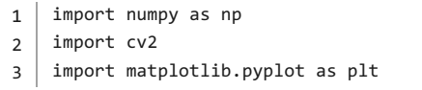
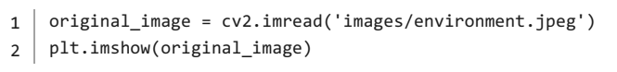
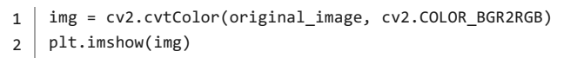
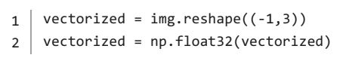
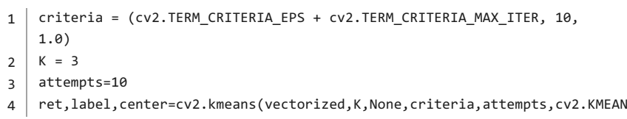
Image Segmentation using K-means
import the necessary libraries
Load image and show using `matplotlib` `imshow()` method
Convert your image from RGB Colours Space to HSV
When clustering the image using k-means, we first need to convert it into a 2- dimensional array whose shape will be (length*width, 3) and convert it to unit 8 value using float 32 as required by OpenCV.
let’s define k, attempts, and criteria as required by K-Means as a parameter
8
Notes:
K-Means clustering is a clustering Algorithm that splits data into k different clusters. We can as well use this algorithm in image segmentation to generate object segments. Below is an example based on K-Means and Opencv.

Slide 10
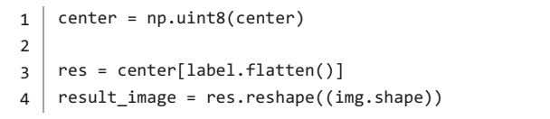
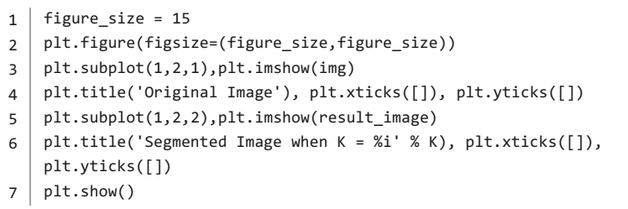
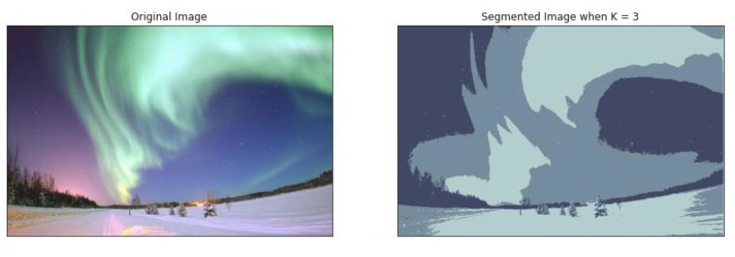
let’s convert back to uint8, and let’s get the clustered image
display the clustered image
9
Notes:
Advantages of Clustering-based Segmentation technique
1-Generate excellent clusters in small datasets
Limitations of Clustering-based Segmentation technique
1-Computation time is too long for a larger dataset
2-Not suitable for clustering non-convex clusters

Slide 11
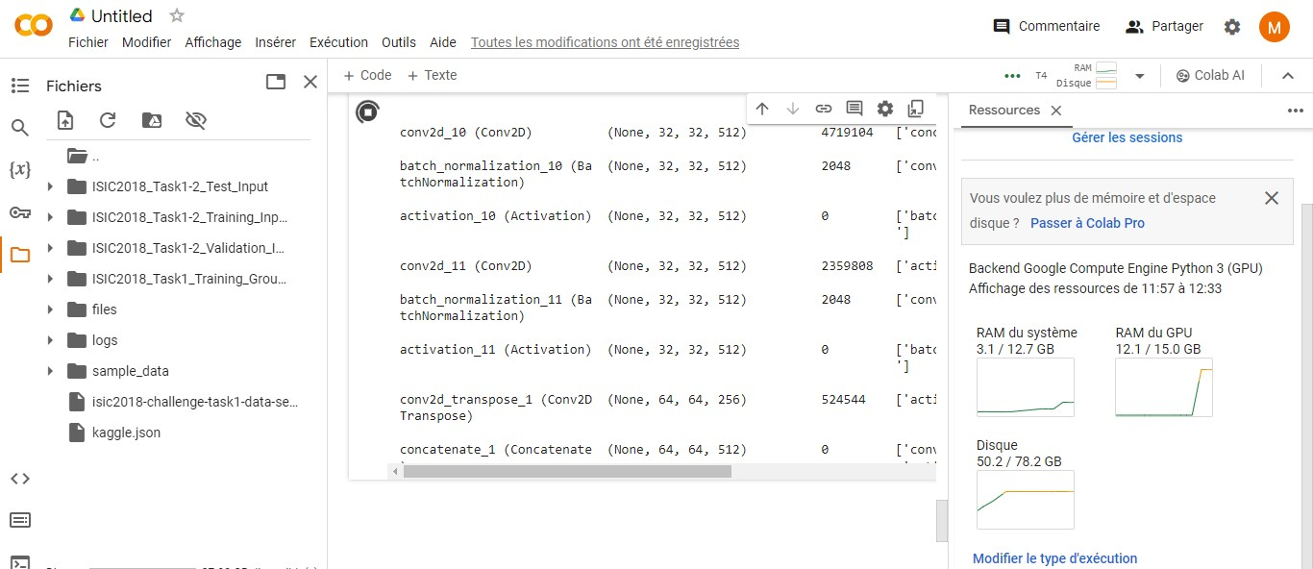
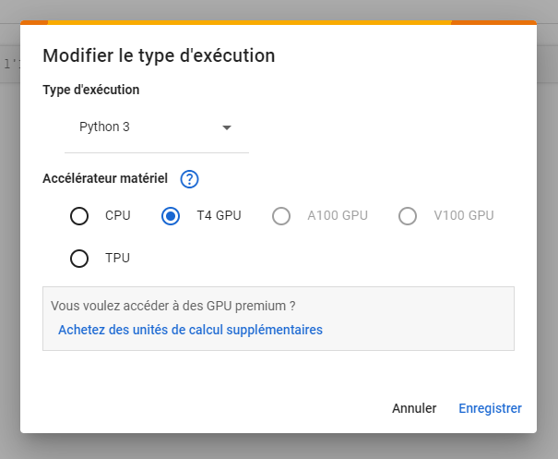
10

Slide 12
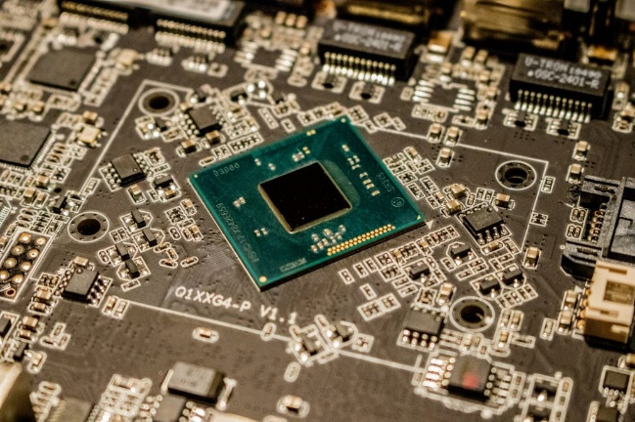
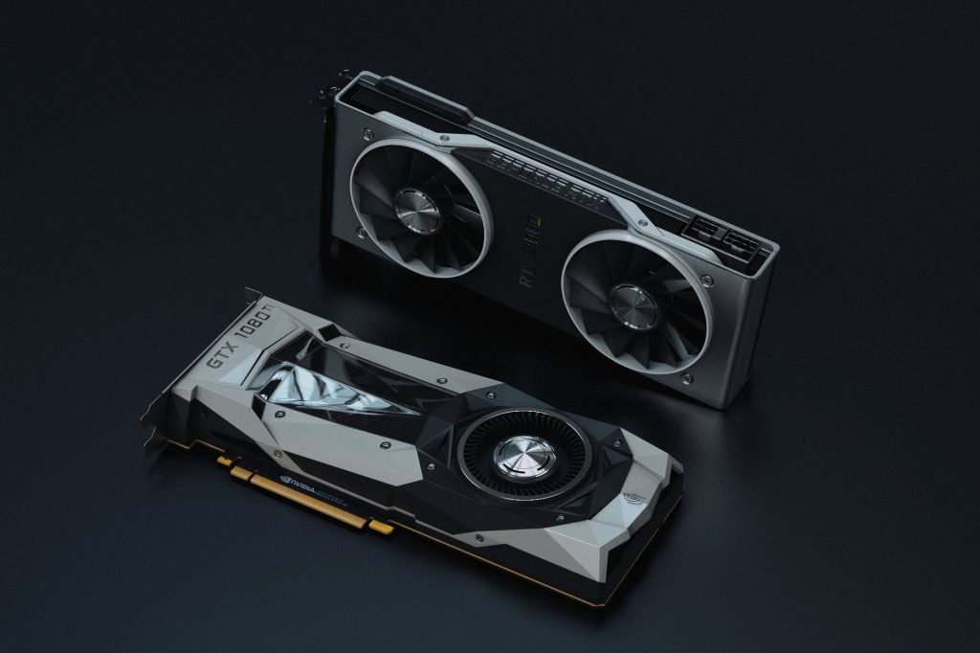
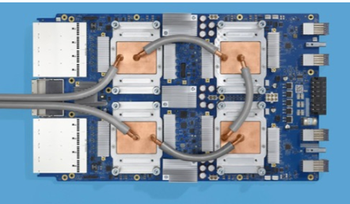
Difference between CPU, GPU and TPU
CPU (Central Processing Unit) | GPU (Graphics Processing Unit) | TPU (Tensor Processing Unit)
Design : General-purpose processor handling all computer functions. Functionality : Executes instructions for computer programs, manages arithmetic, logic, and input/output operations. Manufacturers : Intel, AMD, Qualcomm, NVIDIA, IBM, Samsung. Performance : Handles multiple tasks sequentially but may struggle with heavy graphics or AI work. | Design : Specialized processor for rendering 2D and 3D graphics. Functionality : Enhances graphical performance and accelerates rendering tasks. Applications : Used in gaming, graphic design, video editing, deep learning, and scientific research. Manufacturers : NVIDIA, AMD, Broadcom Limited. | Design : Custom ASIC developed for machine learning tasks. Functionality : Optimized for neural network workloads and TensorFlow projects. Applications : Accelerates deep learning tasks like image and speech recognition. Manufacturer : Google
11

Slide 13
Types of Deep Learning Models
CNNs
Transformers
RNNs
12

Slide 14
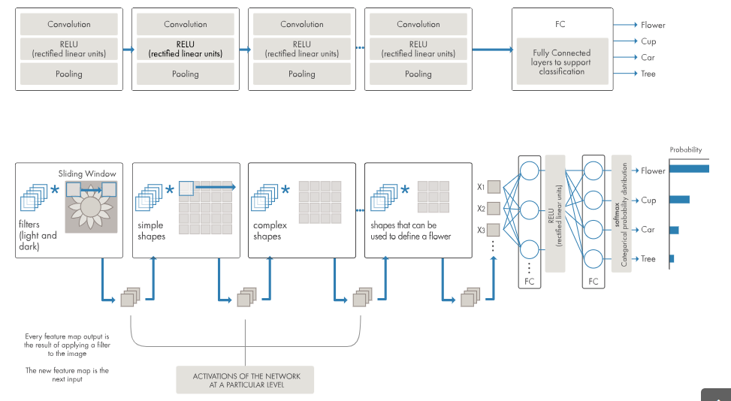
Visualizing an example of a convolutional neural network
13

Slide 15
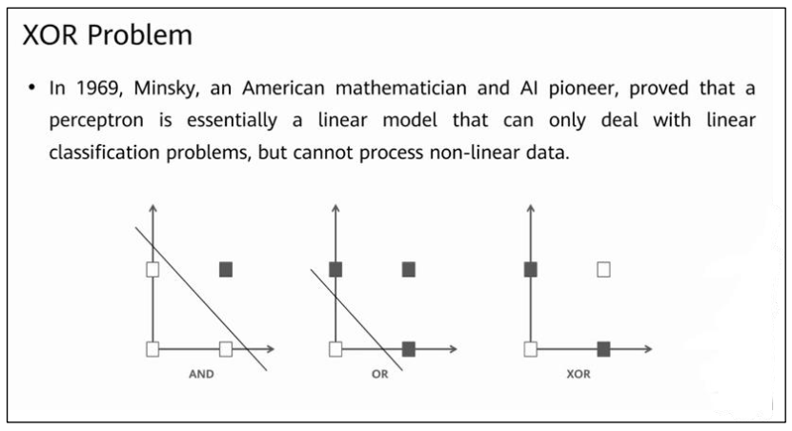
14

Slide 16
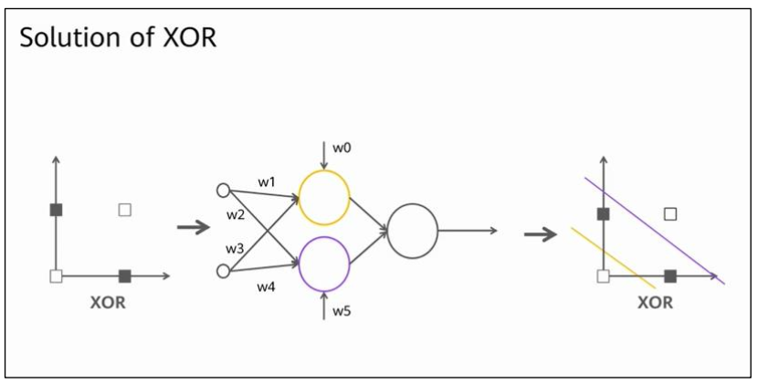
15

Slide 17
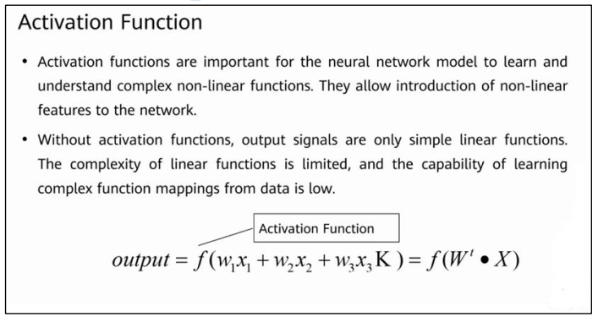
16

Slide 18
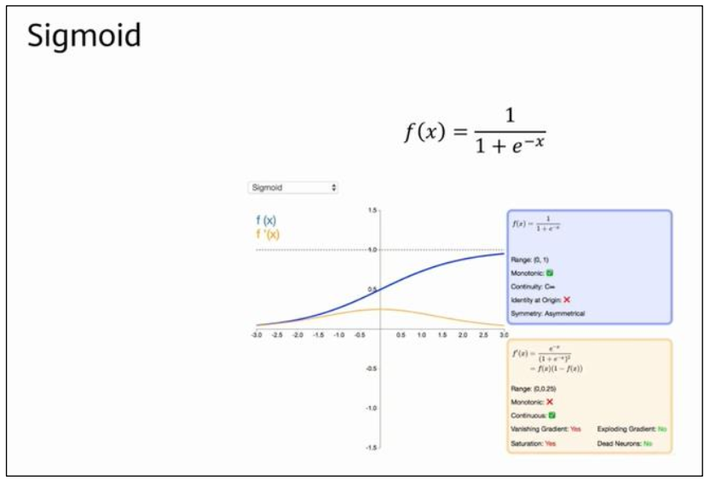
Activation function
17

Slide 19
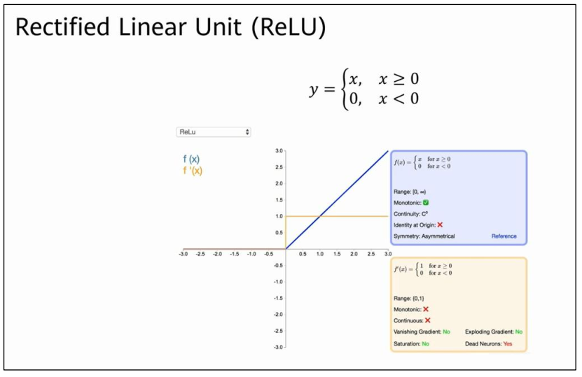
Activation function
18

Slide 20
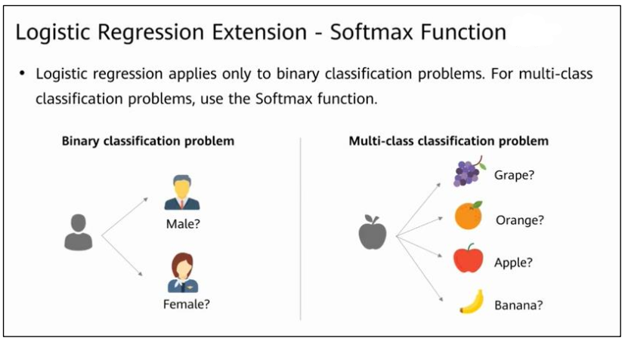
Activation function
19

Slide 21
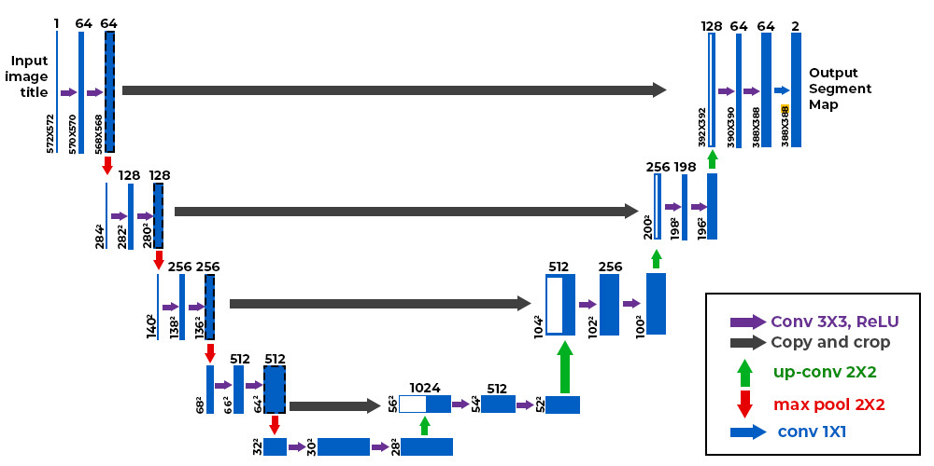
U-Net architecture
Primary Function | Developed for precise biomedical image segmentation
Institution | Computer Science Department, University of Freiburg
Design Benefits | Modified and extended architecture to work with fewer training images and to yield more precise segmentation
Performance | Segmentation of a 512x512 image takes less than a second on a modern GPU
Application in Diffusion Models | Employed in diffusion models for iterative image denoising underpinning image generation models such as DALL-E, Midjourney, and Stable Diffusion
20

Slide 22
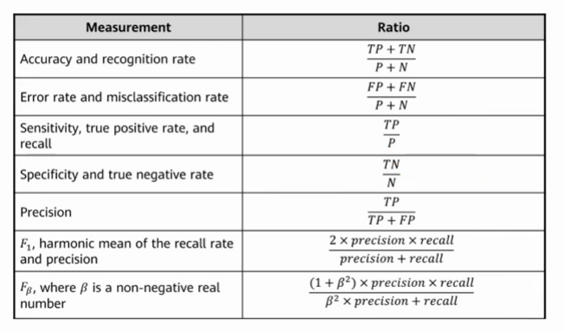
Performance Metrics
Classification applications use four main outputs to generate data :
True positive : the ground truth is positive and the predicted category is also positive
False positive : the ground truth is negative and the predicted category is positive
True negative : the ground truth is negative and the predicted category is negative
False negative : the ground truth is positive and the predicted category is negative
21

Slide 23
Deep learning model training
Step 1: Data Collection and Preprocessing | Data Collection Preprocessing
Step 2: Designing the Model Architecture | Choosing a Model Building the Model
Step 3 : Compiling the Model | Choosing an Optimizer Loss Function Metrics
Step 4 : Training the Model | Feeding Data Epochs Monitoring Training Progress Adjusting Learning Rate Callbacks
22

Slide 24
Step 5 : Evaluating the Model | Validation Metrics Analysis Model Debugging Model Visualization Tools
Step 6 : Model Fine-Tuning | Hyperparameter Tuning Transfer Learning
Step 7 : Saving and Deploying the Model | Saving the Model Deploying the Model
Step 8 : Continuous Learning and Model Updating | Monitoring Model Performance Updating the Model
23

Slide 25
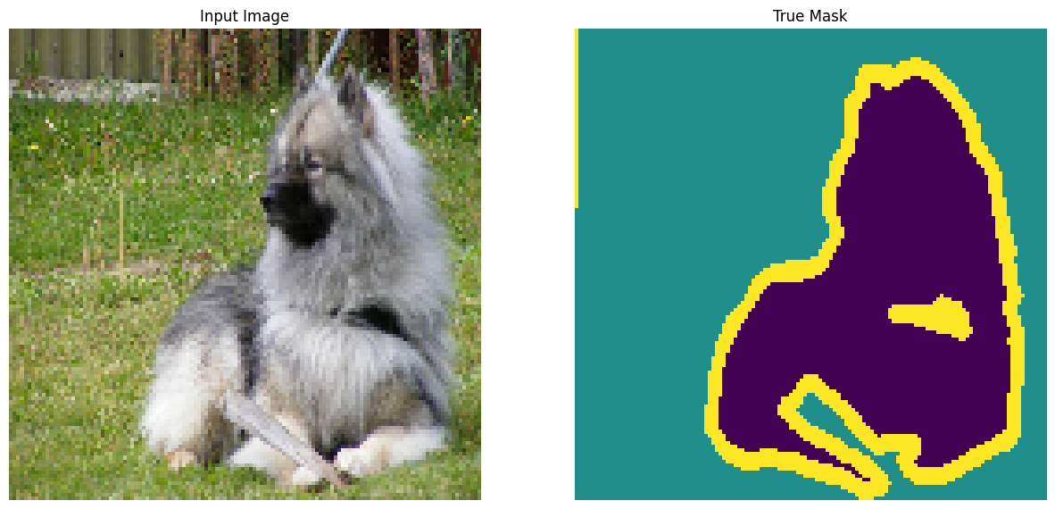
Examples of U-Net segmentation using keras
Pet segmentation
The dataset (Oxford-IIIT Pet Dataset) consists of images of 37 pet breeds, with 200 images per breed (~100 each in the training and test splits). Each image includes the corresponding labels, and pixel-wise masks. The masks are class-labels for each pixel. Each pixel is given one of three categories
Class 1 : Pixel belonging to the pet.
Class 2 : Pixel bordering the pet.
Class 3 : None of the above/a surrounding pixel.
24

Slide 26
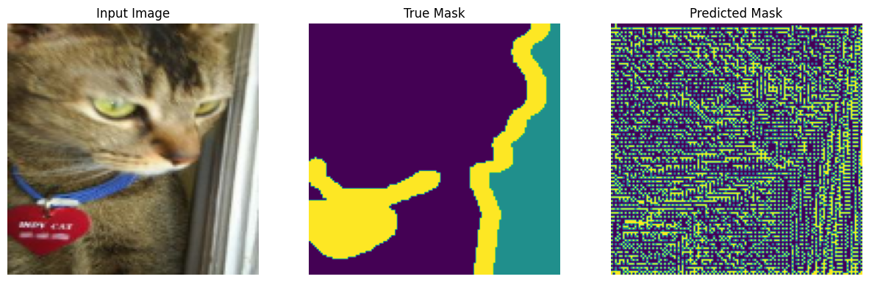
Prediction before training the model
25

Slide 27
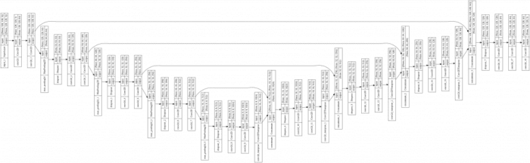
the model
26

Slide 28
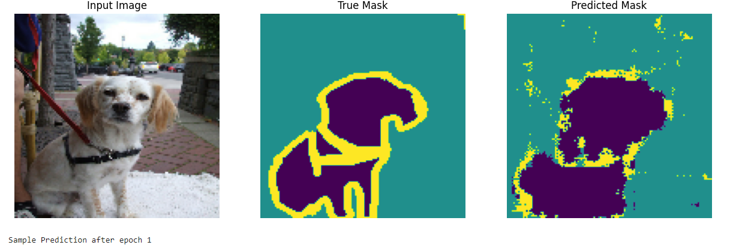
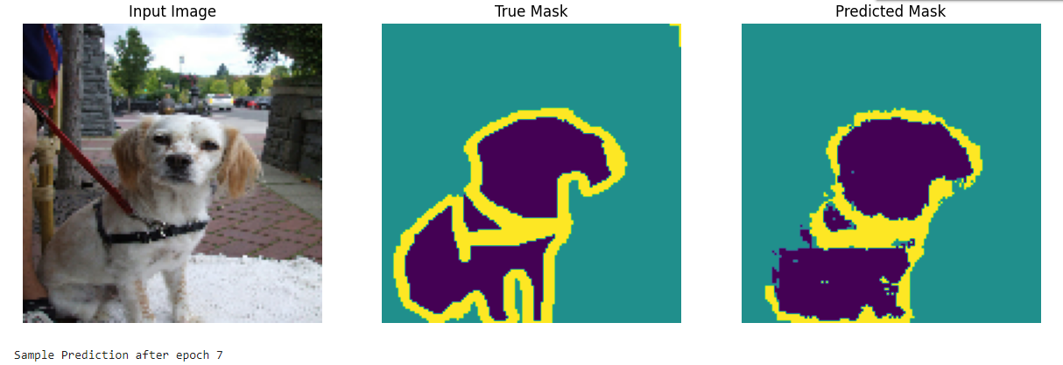
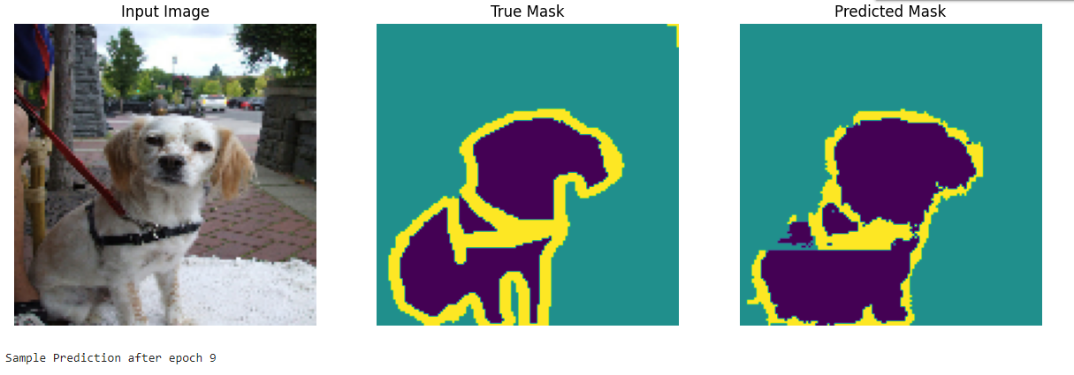
Epoch 1
Epoch 7
Epoch 9
27

Slide 29
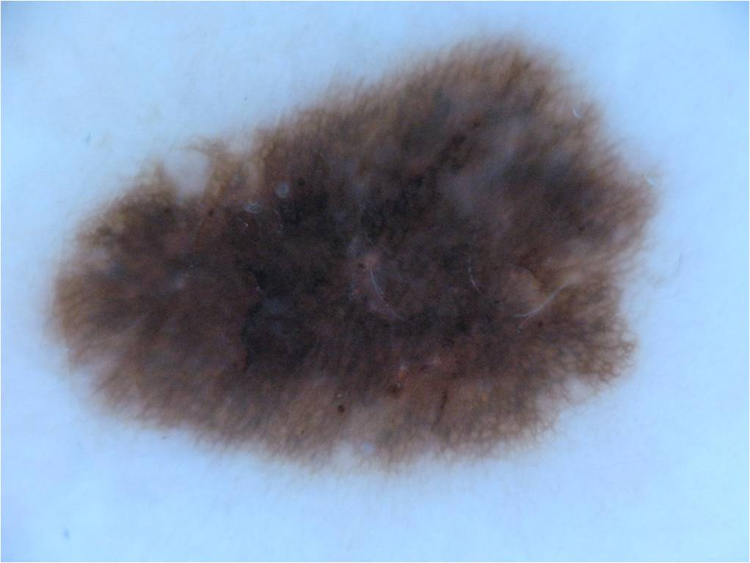
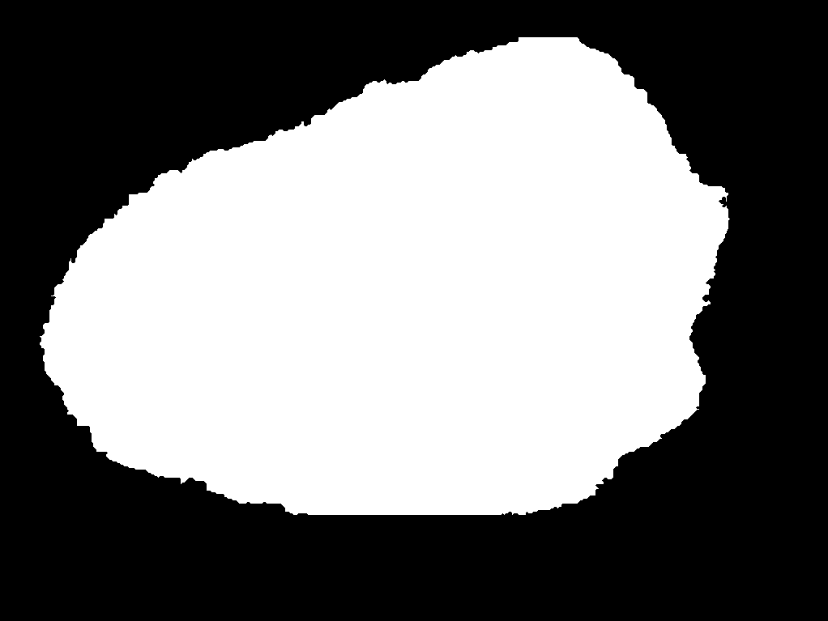
Skin Caner Segmentation
The ISIC-2018 dataset is used for this for training the UNET architecture. The dataset contains the 2596 pairs of images and masks. All of these images are of different shapes and contains a variety of skin lesions.
28

Slide 30
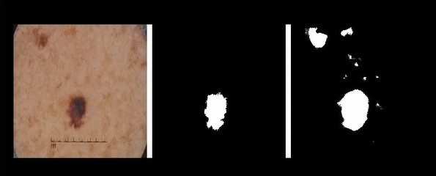
Result over 5 epochs
29

Slide 31
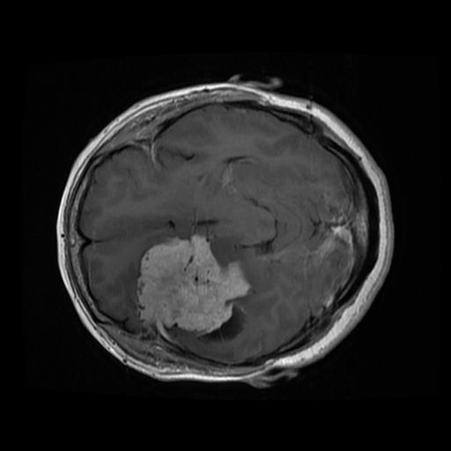

Brain Tumor Segmentation
Dataset used in this project was provided by Jun Cheng. This dataset contains 3064 T1-weighted contrast-enhanced images with three kinds of brain tumor. For a detailed information about the dataset please refer to this site. Version 5 of this dataset is used in this project. Each image is of dimension 512 x 512 x 1, these are black and white images thus having a single channel. Some Data Samples
30

Slide 32
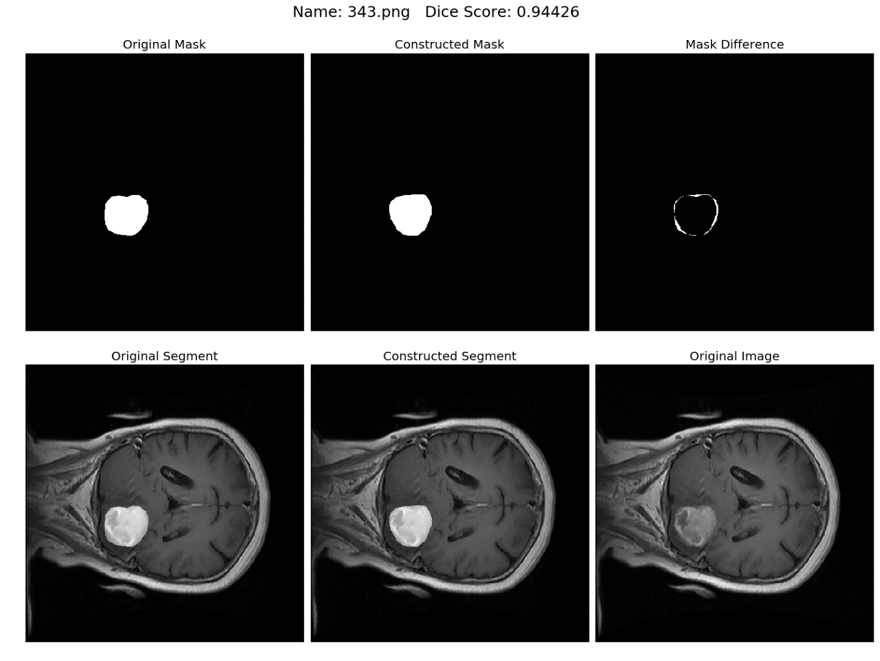
31

Slide 33
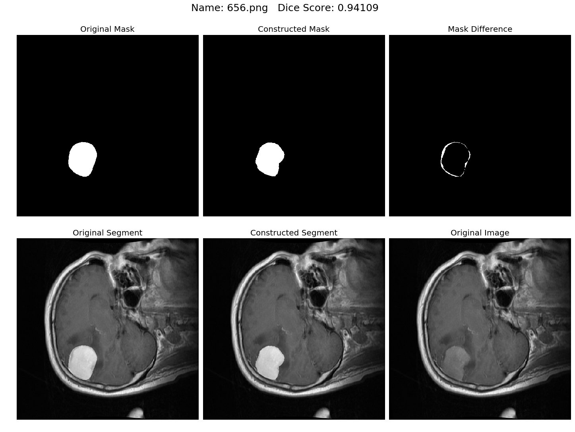
32

